Slide 1

Local interconnect network (LIN)
Presented By: Maxim Speczyk, Stephanie Okosa, Jad Al Jourdi

Slide 2

Why do we need LIN?

Slide 3
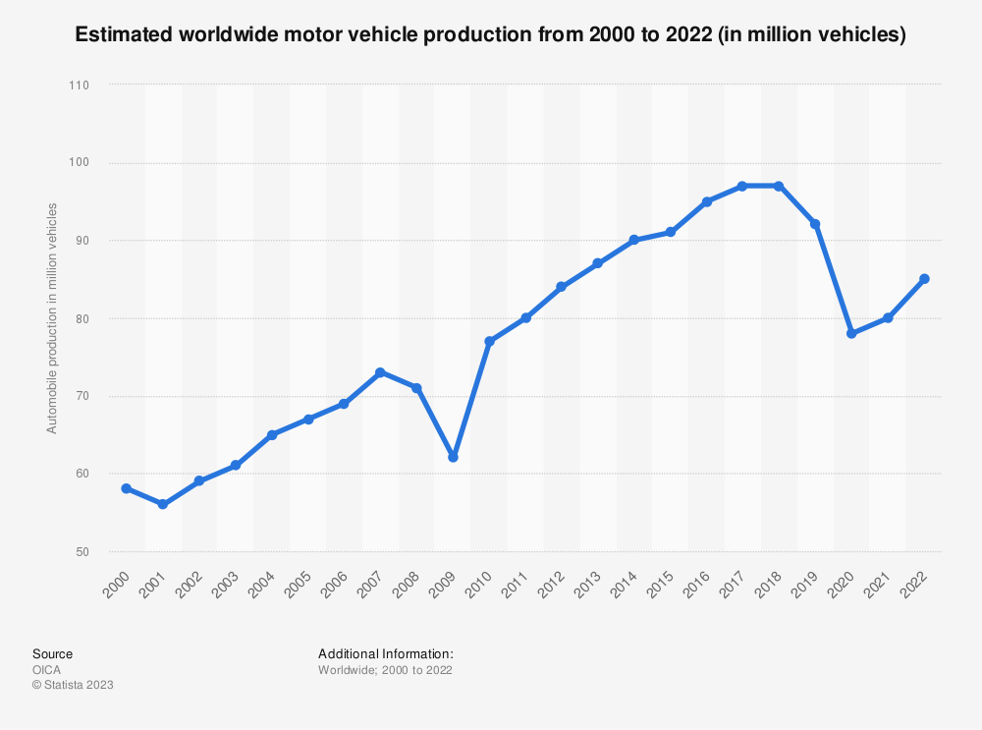
Motivation
[1]

Slide 4

Motivation
Average Price of a vehicle -> $48000
Too High!

Slide 5
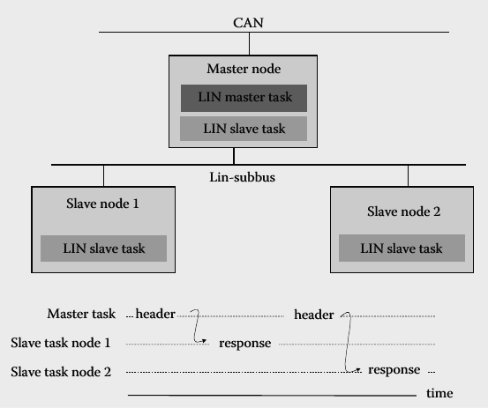
LIN Concept – What is LIN
LIN operates using the Master-slave principle
Message header consist of:
Synchronization break
Synchronization field
Message identifier
Notes:
Usually connected as a subnet of a higher network such as CAN

Slide 6
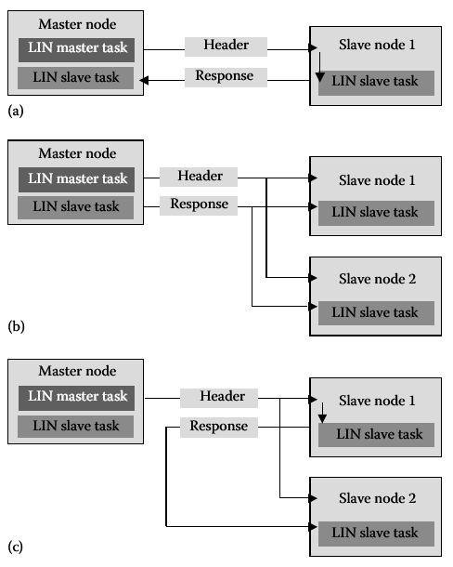
Communication relationships within a LIN cluster:

Slide 7
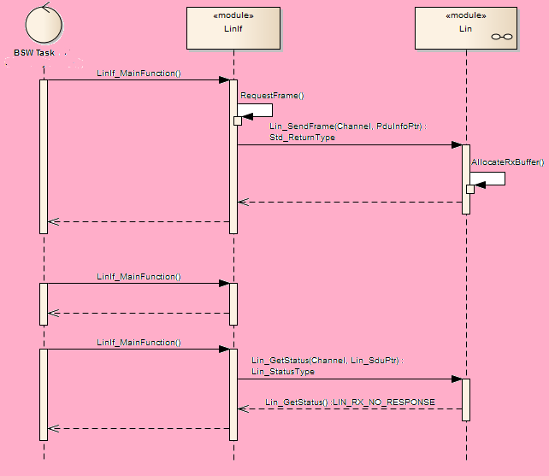
LIN to LIN Communication Sequence Diagram

Slide 8
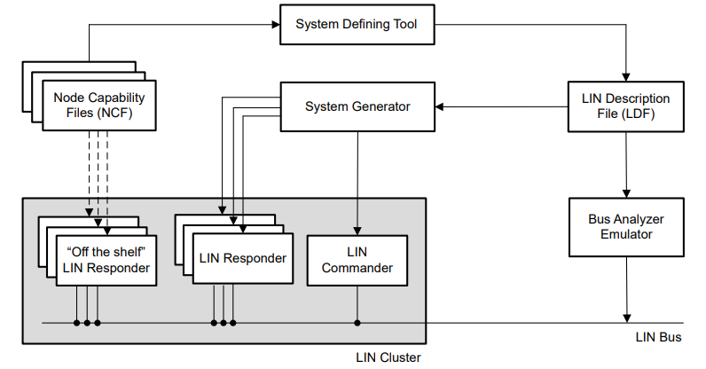
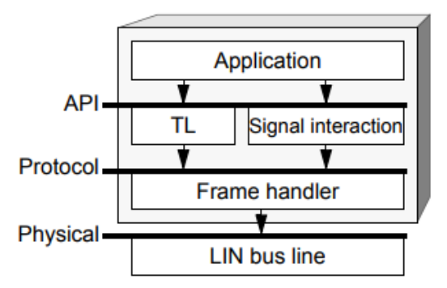
Design Process Workflow
LIN Cluster
Node Concept
Workflow Concept
Configuration Language Specification
Node Capability Language Specification-

Slide 9
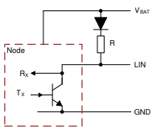
Physical Layer Requirements
Bus Signaling Fundamentals
Pull-up values
Threshold values
Bit rate tolerance

Slide 10
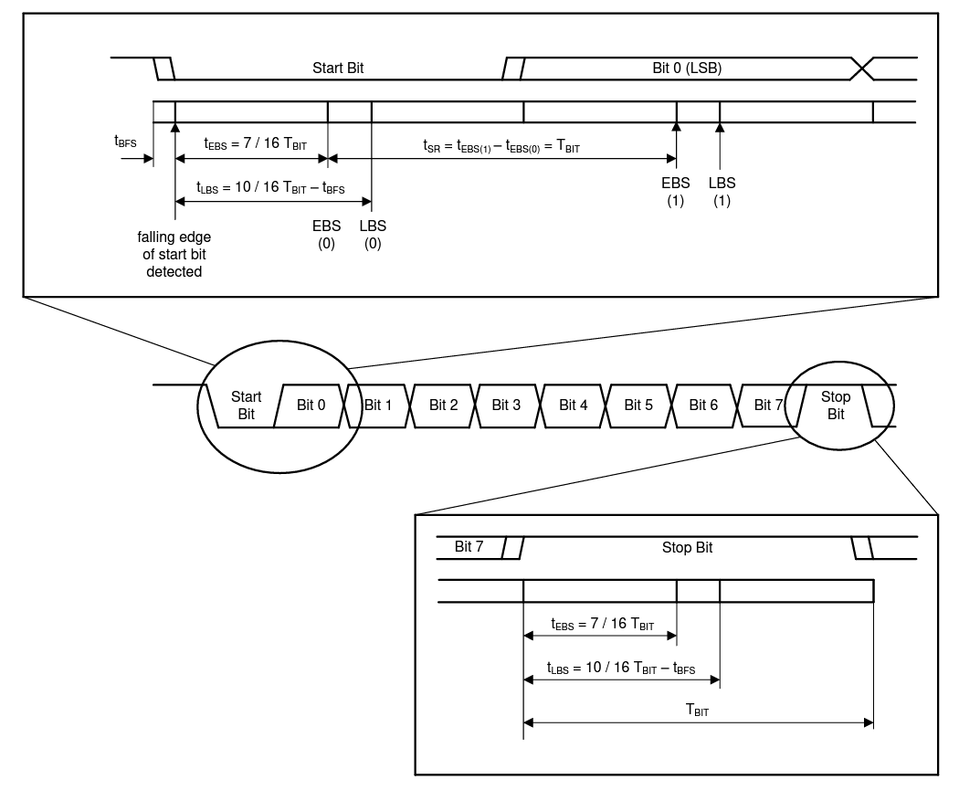
Physical Layer Requirements
Synchronization and Bit-sampling

Slide 11
Applications
Applications that require…
Low Cost
Low Speed
Reliable Latency
Low Data Rates
Ease of Use
Applications like…
Door looks
Window Controls
Dashboard Instruments
Water Pumps
Simple Actuators

Slide 12
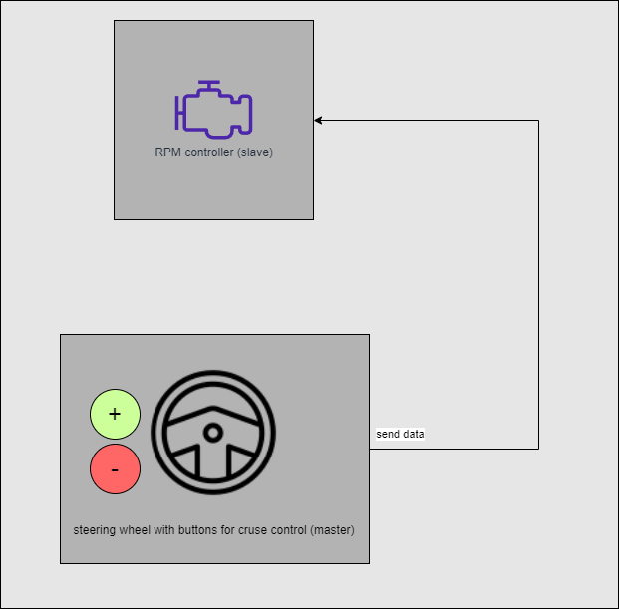
Applicatoin – Cruise Control

Slide 13
Challenges
Limited to 8 bits
Not suited for complex tasks
Poor level of security
Mostly a closed system where security is not that important
Poor transfer rate of 20 Kbit/s
Dependability on the master
If the master fails, the whole system fails

Slide 14
Conclusion
Extremely important for the automotive industry
Due to its low cost
High Versatility
More cost-effective than CAN

Slide 15
Sources
[1] Worldwide automobile production | Statista
[2] Average New Car Price Actually Drops, but It's Still over $48,000 (caranddriver.com)

